Slide 1


A Presentation on “Credit Risk Modelling”
e-DBDA
2021
Guide
Mr. Akshay Tilekar
Student
Mr. Pavan Khairnar (1323)
Mr. Mayur Urane (1355)
INSTITUTES FOR ADVANCED COMPUTING AND SOFTWARE DEVELOPMENT AKURDI, PUNE

Slide 2
CONTENTS
INTRODUCTION
BENEFITS OF CREDIT RISK MODELLING
PROJECT FLOW DIAGRAM
DATA ANALYSIS AND INTERPRETATION
PRELIMINARY DATA EXPLORATION & SPLITTING
WOE BINNING AND FEATURE ENGINEERING
WHAT IS WOE AND IV?
WEIGHT OF EVIDENCE AND IV
PREDICTIVENESS
CONCLUSION

Slide 3
Introduction
What is Credit Risk? In simple words, it is the risk of borrower not repaying loan, credit card or any other type of loan.
What is Credit Risk Modelling? Credit risk modelling refers to data driven risk models which calculates the chances of a borrower defaults on loan (or credit card). If a borrower fails to repay loan, how much amount he/she owes at the time of default and how much lender would lose from the outstanding amount.

Slide 4
Benefits of Credit Risk Modelling
Reduce time to credit decisions
Improve customer experience with intelligent product selection
Check creditworthiness through smart applications
Meet regulatory requirements

Slide 5
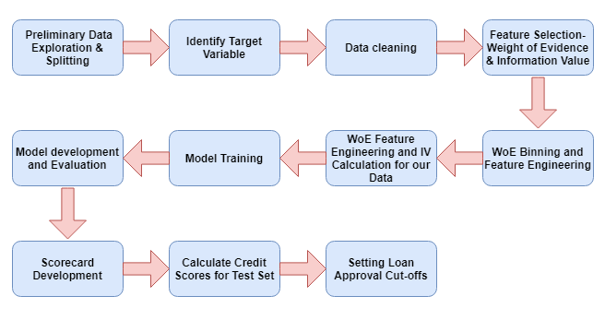
Project Flow Diagram

Slide 6
Data Analysis and Interpretation
Preliminary Data Exploration & Splitting
Data Cleaning
Feature Selection
WoE Binning and Feature Engineering
Information Value (IV)
Model Training
Scorecard Development
Calculate Credit Scores for Test Set

Slide 7
Preliminary Data Exploration & Splitting
We will use a dataset made available on Kaggle that relates to consumer loans issued by the Lending Club, a US P2P lender. The raw data includes information on over 450,000 consumer loans issued between 2007 and 2014 with almost 75 features, including the current loan status and various attributes related to both borrowers and their payment behavior

Slide 8
WoE Binning and Feature Engineering
Creating new categorical features for all numerical and categorical variables based on WoE is one of the most critical steps before developing a credit risk model, and also quite time-consuming
Now , what is WoE and IV?

Slide 9
What is WoE and IV?
Weight of Evidence (WoE) and Information Value (IV) are used for feature engineering and selection and are extensively used in the credit scoring domain.
WoE is a measure of the predictive power of an independent variable in relation to the target variable. It measures the extent a specific feature can differentiate between target classes, in our case: good and bad customers. IV assists with ranking our features based on their relative importance.

Slide 10


Weight of Evidence and IV
The formula to calculate WoE is as follow:
A positive WoE means that the proportion of good customers is more than that of bad customers and vice versa for a negative WoE value.
Information Value (IV)
IV is calculated as follows:

Slide 11
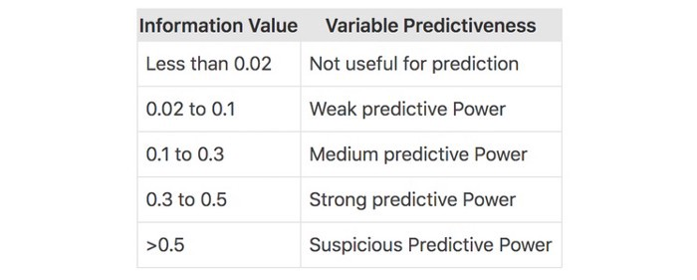
Predictiveness

Slide 12
CONCLUSION
Credit risk modelling in python can help banks and other financial institutions reduce risk and prevent society from experiencing financial crises. Thus, in this way we have created a model to predict probability of person defaulting a loan.

Slide 13
References
Weight of Evidence and Information Value Explained
Baesens, B., Roesch, D., & Scheule, H. (2016). Credit risk analytics: Measurement techniques, applications, and examples in SAS. John Wiley & Sons.
Siddiqi, N. (2012). Credit risk scorecards: developing and implementing intelligent credit scoring. John Wiley & Sons.
Thomas, L., Edelman, D. & Crook, J. (2002). Credit Scoring and its Applications.
Mays, E. (2001). Handbook of Credit Scoring. Glanelake Publishing Company.
Mironchyk, P. & Tchistiakov, V. (2017). Monotone optimal binning algorithm for credit risk modeling

Slide 14
THANK YOU..

